Slide 1



DevOps 2.0: Lesson 3.
Device files and Block device names
Virtual and Hardware Devices
File Systems
Linux Folders (FHS)
File Access modes
www.jobeasy.co

Slide 2
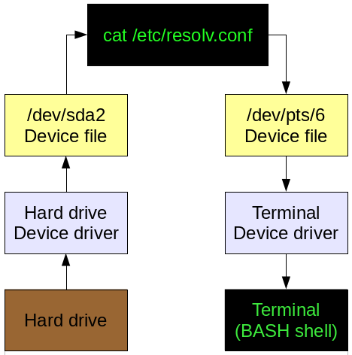
Device files
Device files are also known as device special files. Device files are employed to provide the operating system and users an interface to the devices that they represent. All Linux device files are located in the /dev directory, which is an integral part of the root (/) filesystem because these device files must be available to the operating system during the boot process.
One of the most important things to remember about these device files is that they are most definitely not device drivers. They are more accurately described as portals to the device drivers. Data is passed from an application or the operating system to the device file which then passes it to the device driver which then sends it to the physical device. The reverse data path is also used, from the physical device through the device driver, the device file, and then to an application or another device.
Let's look at the data flow of a typical command to visualize this.
www.jobeasy.co

Slide 3
Block device names
SCSI
Storage devices, like hard disks, SSDs and flash drives, that support the SCSI command (SCSI, SAS, UASP), ATA (PATA, SATA) or USB mass storage connection are handled by the kernel's SCSI driver subsystem. They all share the same naming schёeme.
The name of these devices starts with sd. It is then followed by a lower-case letter starting from a for the first discovered device (sda), b for the second discovered device (sdb), and so on. Existing partitions on each device will be listed with the number that is assigned to them in the partition table, e.g. sda1 for the partition 1, sda2 for partition 2, and so on.
Summary:
/dev/sda - device a, the first discovered device.
/dev/sda1 - partition 1 on device a.
/dev/sde - device e, the fifth discovered device.
/dev/sde7 - partition 7 on device e.
www.jobeasy.co

Slide 4
Block device names
NVMe
The name of storage devices, like SSDs, that are attached via NVM Express (NVMe) starts with nvme. It is then followed by a number starting from 0 for the device controller, nvme0 for the first discovered NVMe controller, nvme1 for the second, and so on. Next is the letter "n" and a number starting from 1 expressing the device on a controller, i.e. nvme0n1 for first discovered device on first discovered controller, nvme0n2 for second discovered device on first discovered controller, and so on. Existing partitions on each device will be listed with the letter "p" and the number that is assigned to them in the partition table. For example, nvme0n1p1 for the partition with number 1 on first discovered device on first discovered controller, nvme0n1p2 for partition 2, and so on.
Summary:
/dev/nvme0n1 - device 1 on controller 0, the first discovered device on the first discovered controller.
/dev/nvme2n5 - device 5 on controller 2, the fifth discovered device on the third discovered controller.
/dev/nvme2n5p7 - partition 7 on device 5 on controller 2.
www.jobeasy.co

Slide 5
Virtual Devices
A virtual device ( Pseudo-devices ) in Unix is a file such as /dev/null or /dev/urandom, that is treated as a device, as far as user level software is concerned, but is generated by the kernel without reference to hardware.
For instance when /dev/null is written to, the kernel tells the program it wrote everything to it (without actually writing it anywhere), and when read from, the reading program is told that it has reached the end of the file. It is a device file (it can be made with mknod for instance), but does not reference any hardware.
Pseudo-devices
Device nodes that do not have a physical device.
/dev/random, see random(4)
/dev/shm
/dev/null, /dev/zero, see null(4)
/dev/full, see full(4)
/dev/ttyX, where X is a number
www.jobeasy.co

Slide 6
File System
In computing, a file system or filesystem (FS) controls how data is stored and retrieved. Without a file system, data placed in a storage medium would be one large body of data with no way to tell where one piece of data stops and the next begins. By separating the data into pieces and giving each piece a name, the data is easily isolated and identified. Taking its name from the way paper-based data management system is named, each group of data is called a "file." The structure and logic rules used to manage the groups of data and their names is called a "file system."
There are many different kinds of file systems. Each one has different structure and logic, properties of speed, flexibility, security, size and more. Some file systems have been designed to be used for specific applications. For example, the ISO 9660 file system is designed specifically for optical discs.
File systems supported by linux:
btrfs, cramfs, ext2, ext3, ext4, fat, gfs2, hfsplus, minix, msdos, ntfs, reiserfs, vfat, xfs, etc
www.jobeasy.co

Slide 7
Linux EXT3 implementations:
Journal is the lowest risk mode, writing both data and metadata to the journal before committing it to the filesystem. This ensures consistency of the file being written to, as well as the filesystem as a whole, but can significantly decrease performance.
Ordered is the default mode in most Linux distributions; ordered mode writes metadata to the journal but commits data directly to the filesystem. As the name implies, the order of operations here is rigid: First, metadata is committed to the journal; second, data is written to the filesystem, and only then is the associated metadata in the journal flushed to the filesystem itself. This ensures that, in the event of a crash, the metadata associated with incomplete writes is still in the journal, and the filesystem can sanitize those incomplete writes while rolling back the journal. In ordered mode, a crash may result in corruption of the file or files being actively written to during the crash, but the filesystem itself—and files not actively being written to—are guaranteed safe.
Writeback is the third—and least safe—journaling mode. In writeback mode, like ordered mode, metadata is journaled, but data is not. Unlike ordered mode, metadata and data alike may be written in whatever order makes sense for best performance. This can offer significant increases in performance, but it's much less safe. Although writeback mode still offers a guarantee of safety to the filesystem itself, files that were written to during or before the crash are vulnerable to loss or corruption.
www.jobeasy.co

Slide 8
FileSystem Hierarchy Standard (FHS)
PRESENTATION: FileSystem Hierarchy Standard
www.jobeasy.co

Slide 9
Hidden -Dot- Files
There are some files within the home directory that are ordinarily hidden. Hidden files have names that begin with a period; hence, they have been given the nickname of dot files.
Hidden files are not displayed by the ls command unless the -a option is used in the format of ls -a.
www.jobeasy.co

Slide 10
Dot Files examples:
.bash_history: For users of the bash shell, a file containing up to 500 of the most recent commands available for recall using the up and down arrow keys.
.bash_logout: Script that is run by the bash shell when the user logs out of the system
.bash_profile: Initialization script that is run by the bash shell upon login in order to setup variables and aliases. When bash is started as the default login shell, it looks for the .bash_profile file in the user?s home directory; if not found, it looks for .bash_login. If there is no .bash_login file, it then looks for a .profile file.
.bashrc: Initialization script executed whenever the bash shell is started in some way other than a login shell. It is better to put system-wide functions and aliases in /etc/bashrc, which will be presented later in the book.
.profile: Put default system-wide environment variables in /etc/profile.
.viminfo: Initialization file for the Vim text editor that is compatible with vi.
.xinitrc: The initialization file used when running startx, which can be used to activate applications and run a particular window manager.
.xsession: This file is executed when a user logs in to an X-terminal and is used to automatically load the window manager and applications.
www.jobeasy.co

Slide 11
File Access Modes
The permissions of a file are the first line of defense in the security of a Unix system. The basic building blocks of Unix permissions are the read, write, and execute permissions, which have been described below −
Read: Grants the capability to read, i.e., view the contents of the file.
Write: Grants the capability to modify, or remove the content of the file.
Execute: User with execute permissions can run a file as a program.
www.jobeasy.co

Slide 12
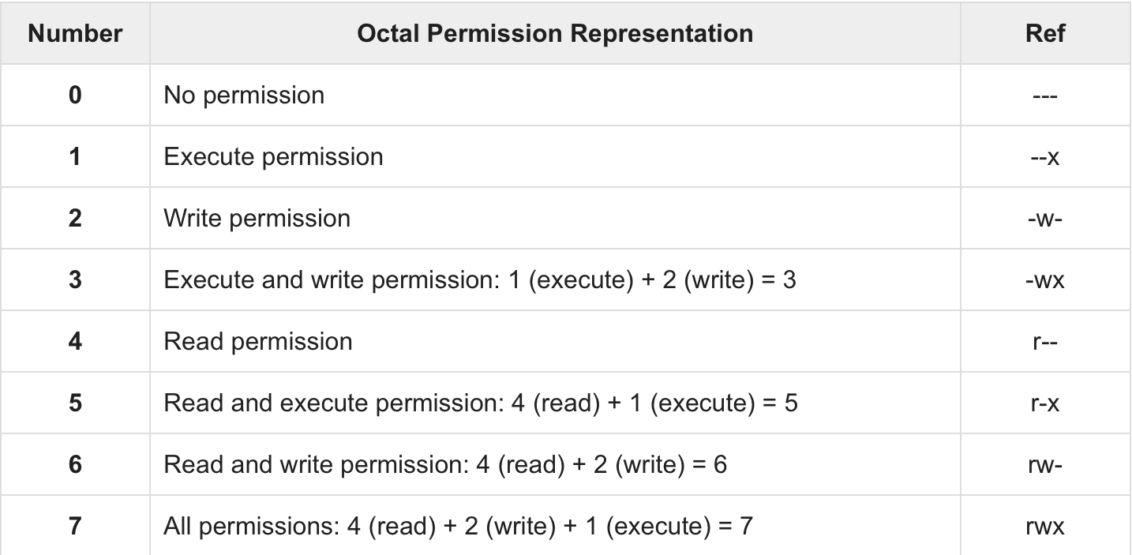
File Access Modes
Using chmod with Absolute Permissions
The second way to modify permissions with the chmod command is to use a number to specify each set of permissions for the file.
Each permission is assigned a value, as the following table shows, and the total of each set of permissions provides a number for that set.
www.jobeasy.co

Slide 13
How To set Permissions in Linux
chmod +rwx filename to add permissions.
chmod -rwx directoryname to remove permissions.
chmod +x filename to allow executable permissions.
chmod -wx filename to take out write and executable permissions.
chmod 600 filename Only Owner can Read and Write
chmod 644 filename Owner can Read and Write, others can Read
chmod 750 filename Owner can Read,Write, Exec, group - Read and Exec
chmod 777 filename All can Read, Write, Exec
chmod 400 filename Owner can Read
www.jobeasy.co

Slide 14

Questions?
www.jobeasy.co

Slide 15



Take your career to the next level!
www.jobeasy.co support@jobeasy.co
(415) 319-9099
See you later

